Slide 1
REIMAGINE AND REVITALIZE GRANT OPPORTUNITY
Information Session
June 16, 2026
Notes:
Shelly

Slide 2
AGENDA
UWGNH Overview & R2 Overview
Eligibility & Application Requirements
Timeline
Post-Award Requirements
Q&A
Notes:
Shelly

Slide 3
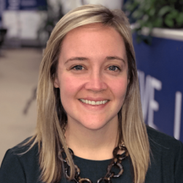


Kelly Fitzgerald
Shelly Hicks
Megan Neely
VP of Financial Security
VP of Education
Operations Manager
Notes:
Shelly

Slide 4
OVERVIEW
Notes:
Shelly

Slide 5
Mission​
We mobilize people and resources to drive community change so everyone can thrive.
Vision​
Greater New Haven is a community where all children are nurtured, all families are financially secure, and everyone has opportunities to reach their full potential.
ABOUT UWGNH
Values
We respect diverse perspectives and foster a culture of inclusivity
We approach our work and each other with curiosity focused on continuous improvement
We celebrate wins and acknowledge growth
We hold ourselves accountable to our values and commitments
We provide outstanding service to our community and each other
Notes:
Shelly

Slide 6

Program Background
The Council’s R2 Program is funded through licensing fees and revenues generated from Connecticut’s adult-use cannabis market and dedicated to social equity initiatives
These funds are administered by the Council to support community reinvestment, workforce development, and technical assistance along with other initiatives consistent with the purposes of the Council
A competitive grant program administered by selected grant managers to support community-based initiatives in municipalities and neighborhoods disproportionately impacted by the War on Drugs
The program provides funding to eligible organizations to implement projects focused on long-term community revitalization
R2 PROGRAM
Notes:
Shelly

Slide 7
Program Priorities
Economic Development
  Economic development ignites economic growth by enhancing access to vital resources and capital to drive forward economic development initiatives, including shovel-ready projects
  Programs supported include job training, access to employment, workforce development, neighborhood revitalization, and repair or limited renovations to a property
R2 PROGRAM
Notes:
Kelly

Slide 8
Program Priorities
Reentry Initiatives
  Reentry Initiatives (Justice-Impacted Adults and Youth) support the transition of justice-impacted individuals back into communities, focusing on reducing recidivism and promoting social reintegration
  Programs include but are not limited to employment/legal/housing assistance, social support and mental health services, educational and vocational training, and more (see NoFo)
R2 PROGRAM
Notes:
Kelly

Slide 9
Program Priorities
Youth Initiatives
  Programming that provides educational or social opportunities, mentorship, or other resources to support the development of children and youth
  Programs include nutritional education, mental health support, education and academic support, life skill training, mentorship, internships, youth entrepreneurship, and more (see NoFo)
R2 PROGRAM
Notes:
Shelly

Slide 10
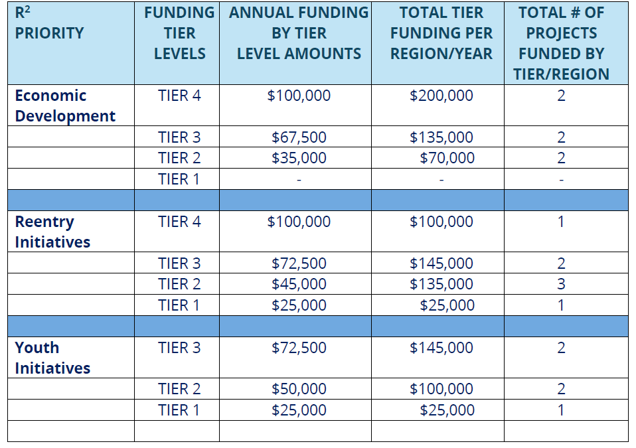
Program Funding Tiers
R2 PROGRAM
Funding is annual for 3 years:
Grant period is October 1, 2026- September 30, 2029.
Funding is structured via four tiers based on annual requests. Applicants are required to select a tier that aligns with staffing levels and capacity. The priority area applicants select determines tier availability.
Tier 3 and Tier 2 amounts vary by priority area to accommodate different program needs
Notes:
Kelly

Slide 11
ELIGIBILITY & APPLICATION REQUIREMENTS
Notes:
Kelly

Slide 12
R2 ELIGIBILITY
Organization Eligibility
Nonprofit CBOs with 3 or more years of experience providing programs aligned with one or more of the program priorities.
Entity registered with the Secretary of State of Connecticut.
Nonprofit located in and serving residents from designated R2 regions (East Haven, West Haven, New Haven).
Notes:
Kelly

Slide 13
Program Eligibility
R2 ELIGIBILITY
Eligible organizations may only submit one application per region
Programs must align with at least one priority area indicator
Must have 3 or more years of experience providing programs aligned with one or more of the program priority areas and within the DIA. If a program is newer (e.g., incorporated recently) they must demonstrate in their application 3+ years of experience in the priority area within the DIA
Service population: Applicant must certify that the program serves 90-100% residents from the specific Target Region applied for. (that 90-100% can be a combination from all 3 towns)
Programs must have a physical footprint in East Haven, West Haven, or New Haven
  If an entity’s headquarters is in an alternate location, they are eligible to apply if they either rent or own a space in East Haven, West Haven, or New Haven
Notes:
Kelly

Slide 14
Required Supporting Documents*
R2 REQUIREMENTS
2 years of audited/CPA-prepared financial statements
Org chart and Board/Advisory Committee list
Proof of CT Secretary of State registration
Resumes for key personnel
2 letters of support
Signed Statement of Assurances and Conflict of Interest Disclosure
Itemized budget with narrative (flat-rate admin % not permitted)
*Applicants are required to submit the above documentation using the templates provided on the UWGNH R2 webpage (Addendum #4). If you encounter technical issues, please reach out to secr2@uwgnh.org.
Notes:
Kelly

Slide 15
Application Platform/Process
R2 PROCESS
Navigate to https://uwgnh.org/reimagine-and-revitalize
Draft responses by downloading the Application Questions document on the United Way of Greater New Haven R2 webpage
Required submission attachments and templates are also on our website, under Addendum #4. Applicants are required to download/update/submit these documents as part of their complete application
When ready to submit, input responses via our online grant platform Intellistack/Formstack. Link on our R2 webpage: R2 Funding Application—save & submit function is available*
*Please assign one person to input final responses, save & submit function serves as a backup. Applicants are strongly encouraged to draft responses outside of online platform.
Notes:
Kelly

Slide 16
TIMELINE
Notes:
Megan

Slide 17
TIMELINE
Information Session
June 16
Questions Due
June 19
Application Due ​
July 15 5pm
Review Period
July- August 2026
Awards Announced
By September 2026
Applicant questions may be sent to secr2@uwgnh.org
Notes:
Megan

Slide 18
POST AWARD REQUIREMENTS
Notes:
Shelly

Slide 19
Reporting & Evaluation
POST AWARD
Quarterly Programmatic Reporting | Due the month following the end of the quarter To include, identifying characteristics of the organization, organizational statistics as it relates to staff operations and capacity changes, and demographic information of clients served Each priority area will have specific items to report on
Monthly Financial Reporting | Due by the end of each month
Annual Cumulative Report | A 12 month cumulative report due at the end of each grant year
Site Visits | Once a year, scheduled by grant manager with organization staff
Notes:
Shelly

Slide 20
POST AWARD
Site Visits
Site Visits will include:
  A review of records maintained by the CBO
  Observation of the programming as permitted by regulations and guidelines
Notes:
Shelly

Slide 21
POST AWARD
Capacity Building Training
Topics to be covered include:
Performance Data and evaluation
Financial Management for non-profits
Project Management
AI for non-profits
Establishing Strategic Partnerships
Grant Writing Strategies
Notes:
Shelly

Slide 22
Social Equity Council FAQs
Please review the full list of FAQs as published by the Council. A link to this information is available on our website
Additional FAQs
Any other questions are welcome to be submitted to secr2@uwgnh.org no later than June 19th, 2026. Answers will be updated on our webpage with guidance from the Council on a rolling basis
Additional questions received as of 6/16 touch on:
  Core application re-submissions or amendments (not allowed)
  Timeline for completing application submission if notified by GM of missing attachments/addendums (48 hours via email from notification date/time)
  Eligibility if headquartered outside of the DIA but operating within it (Yes, an organization would still be eligible if renting or owning physical space in the DIA)
FAQs
Notes:
Kelly

Slide 23
Q&A
Notes:
Kelly

